Slide 1





ঋতু
Heal The World.
Our mission and goals for the future

Slide 2

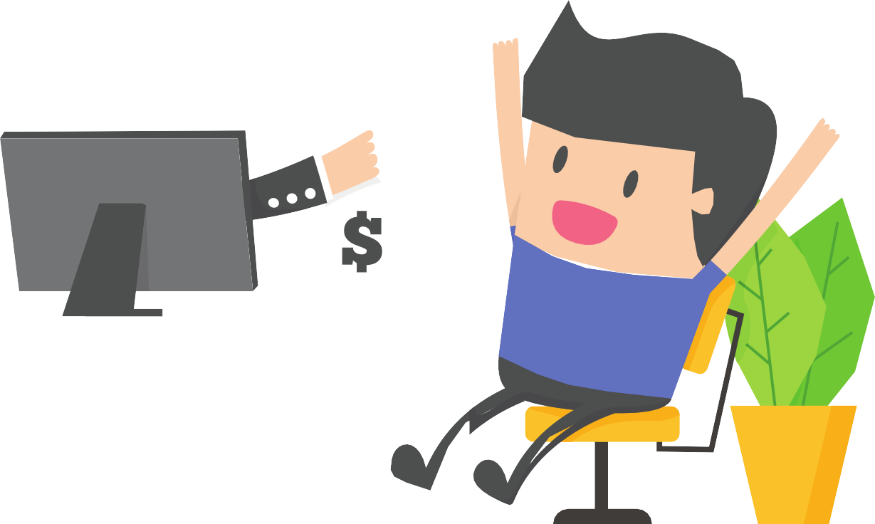

ADVANTAGES OF INSTALLING OUR GAME
1.GETTING REWARDS AND MONEY
2. CITIZEN REWARDS
3.GETTING A POLLUTION FREE ENVIRONMENT

Slide 3



ABOUT THE GAME
10 Tasks per season (Total season=6)
Rewards in every season
PERFORMING TASK FOR THE WELFARE OF THE ENVIRONMENT

Slide 4

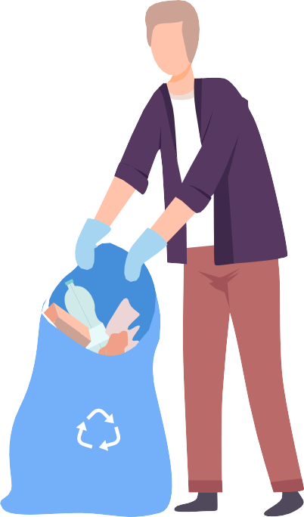
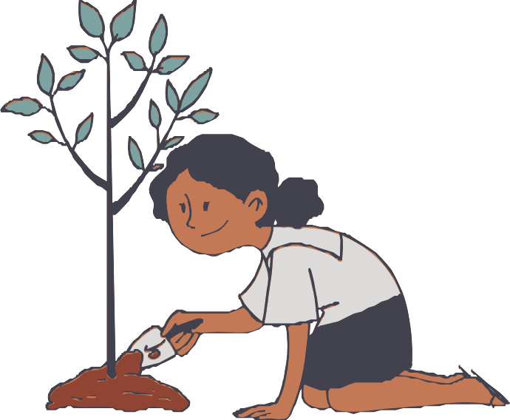






Advertising Through Hashtags Collecting Plastics
Some Tasks of the Game
Planting tress
Using long lasting bulbs
Using Jute Bags
Cleaning Roads
Promoting organic farming

Slide 5


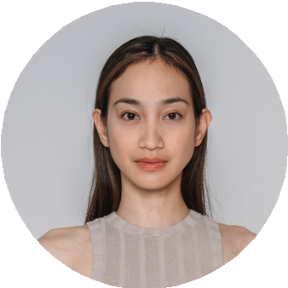
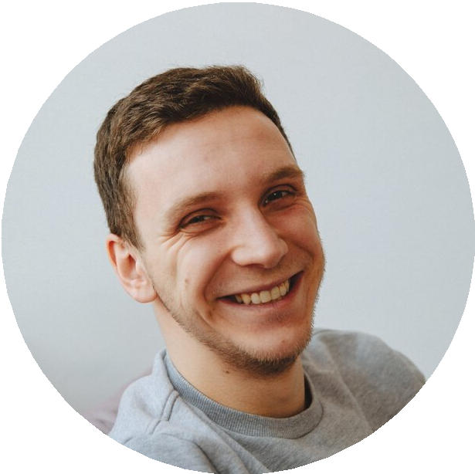

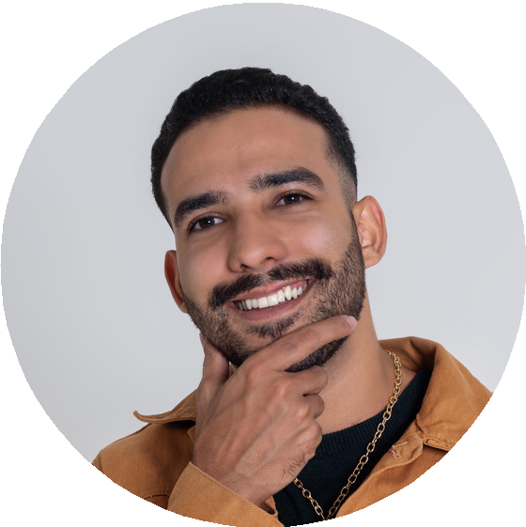
LEADERBOARD
Position
Tasks Won
Total points
Seasons Played
1.
Joanne
10
97.5
1
2.
9
85.5
1
Darrel
3.
8
80
1
Jen
4.
Aries
7
68
1

Slide 6


System Architecture of the app

Slide 7


USER DATA
MAIN
UI
REGISTRATION
SQL DATABASE
LOGIN
PLAYER
INTERFACE
DATA QUERY
SORTING
ALGORITHM
POINTS DATA
FINAL
UI
LEADERBOARD
TASKS

Slide 8



Slide 9
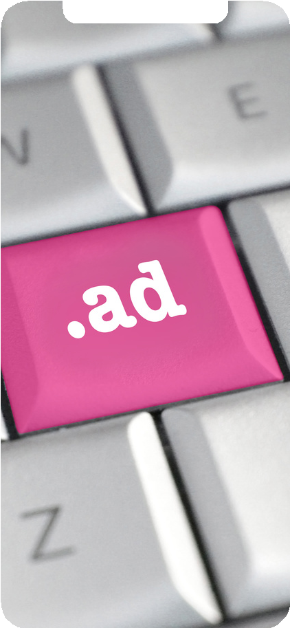
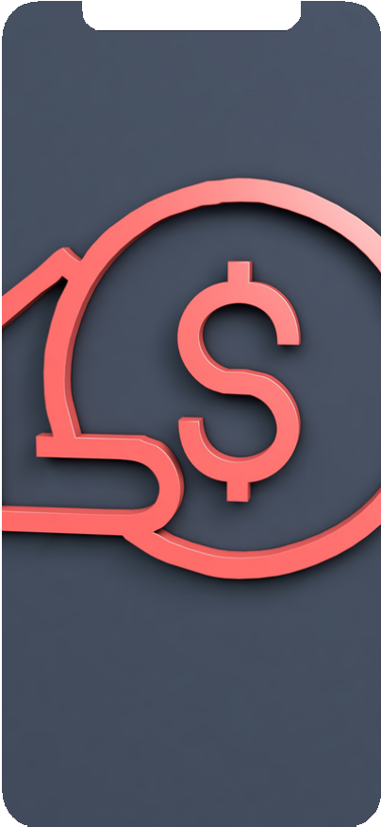
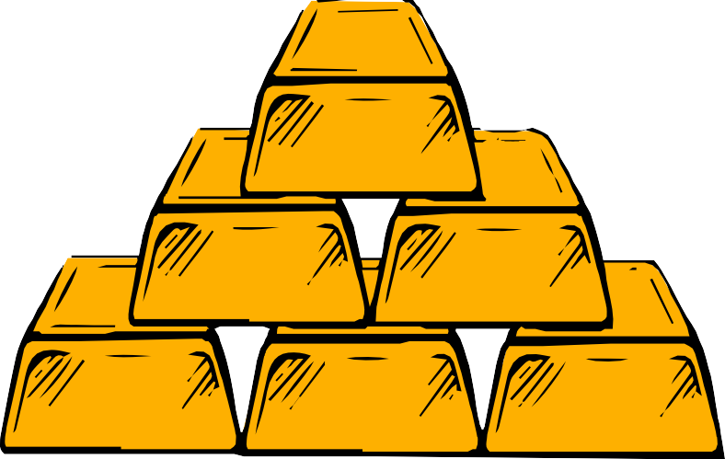
HOW DO WE MONETIZE
IN-GAME ADVERTISING
IN-GAME PURCHASE

Slide 10
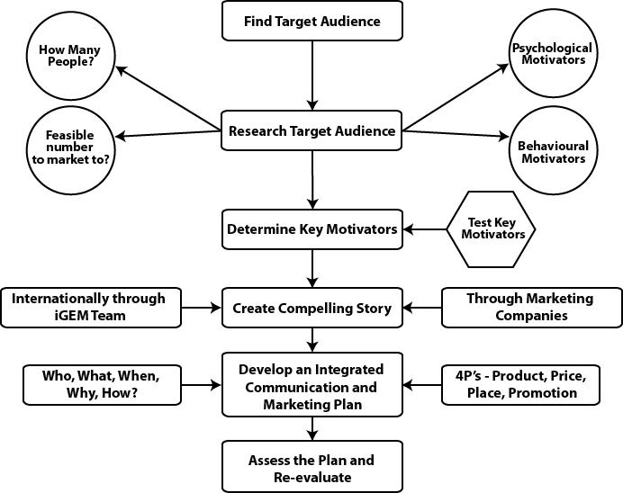
CAPITAL OVERFLOW

Slide 11






HOW DO WE PROMOTE OUR PRODUCT?
SOCIAL MEDIA
POSTS (facebook, instagram)
INFLUENCE MARKETING
( influencer, celebrities)
3
1
Video content (youtube, facebook,instagram)
2
HASHTAGS
(facebook, instagram)
4

Slide 12
HOW DO WE GET OUR FUNDINGS?
3 step Funding plan

Slide 13

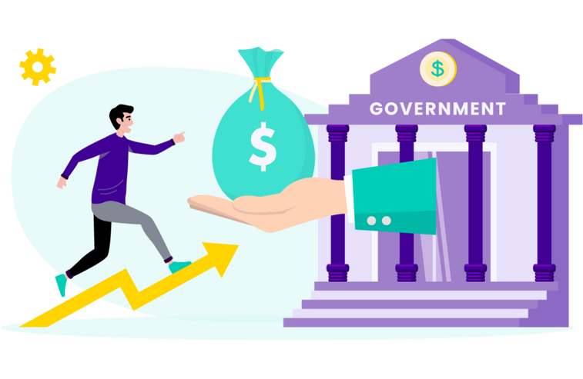

HOW OUR COMPANY GETS BENEFITTED
1. COMPANY SPONSORS
2. GOVERNMENT FUNDING
3. IN GAME PURCHASE

Slide 14





1,00,000 BDT Prize money for winners
SEASON WINNERS
30% of the total income will be given to the Investors to cover their investment
30%
Investors
70%
Rest of the money is retained to the company fund
COMPANY FUND
14

Slide 15
Future Goals Of Ritu.
Many more features to come !

Slide 16

Thank you!
Download RITU for a Better World

